Slide 1
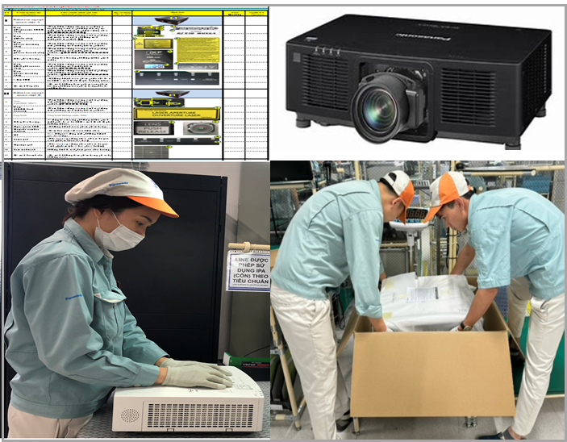
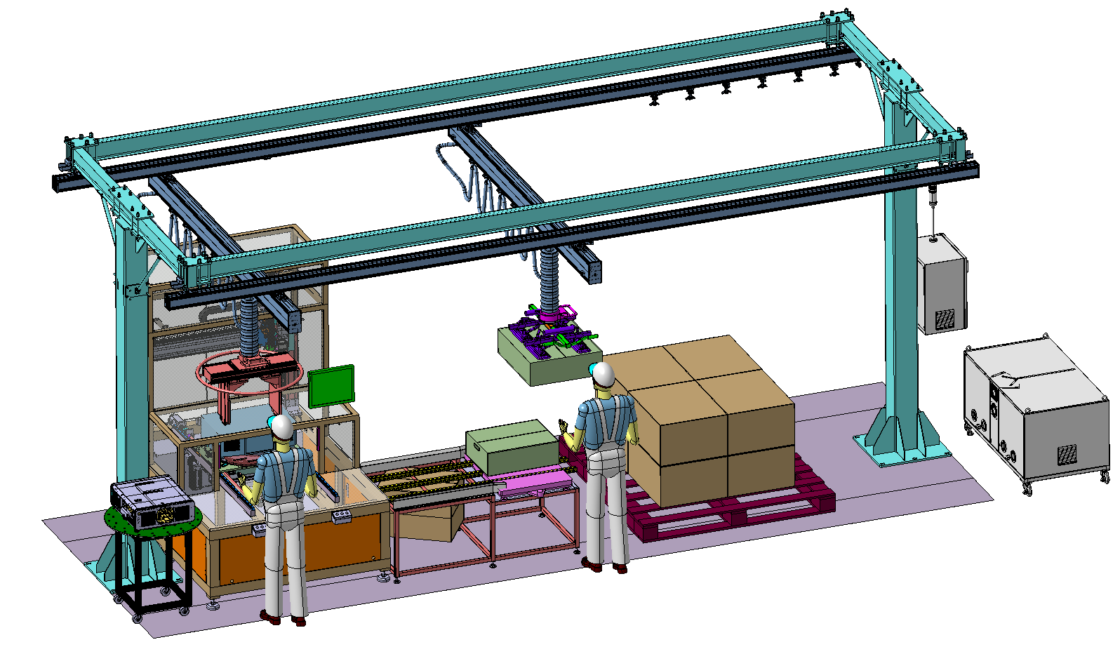
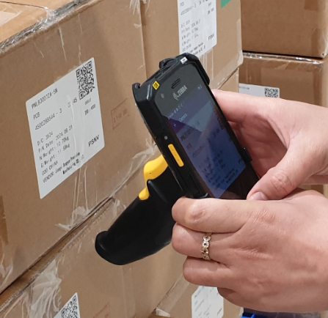
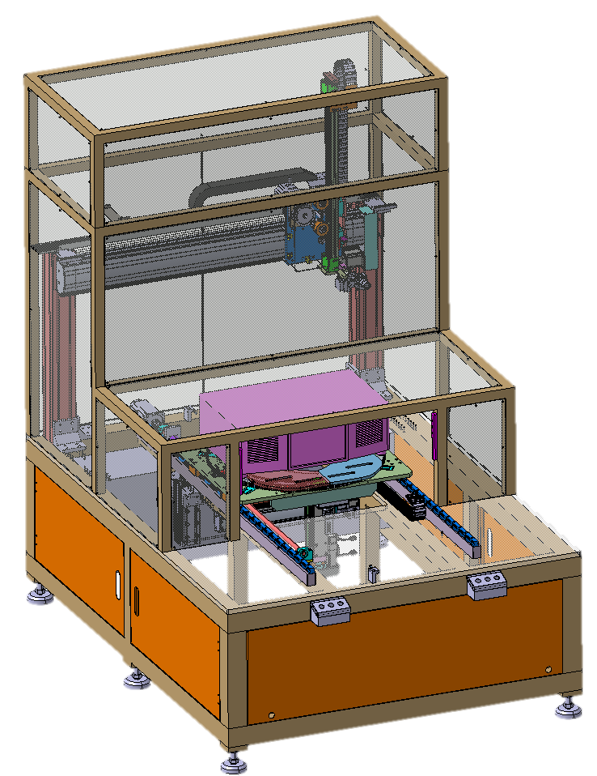



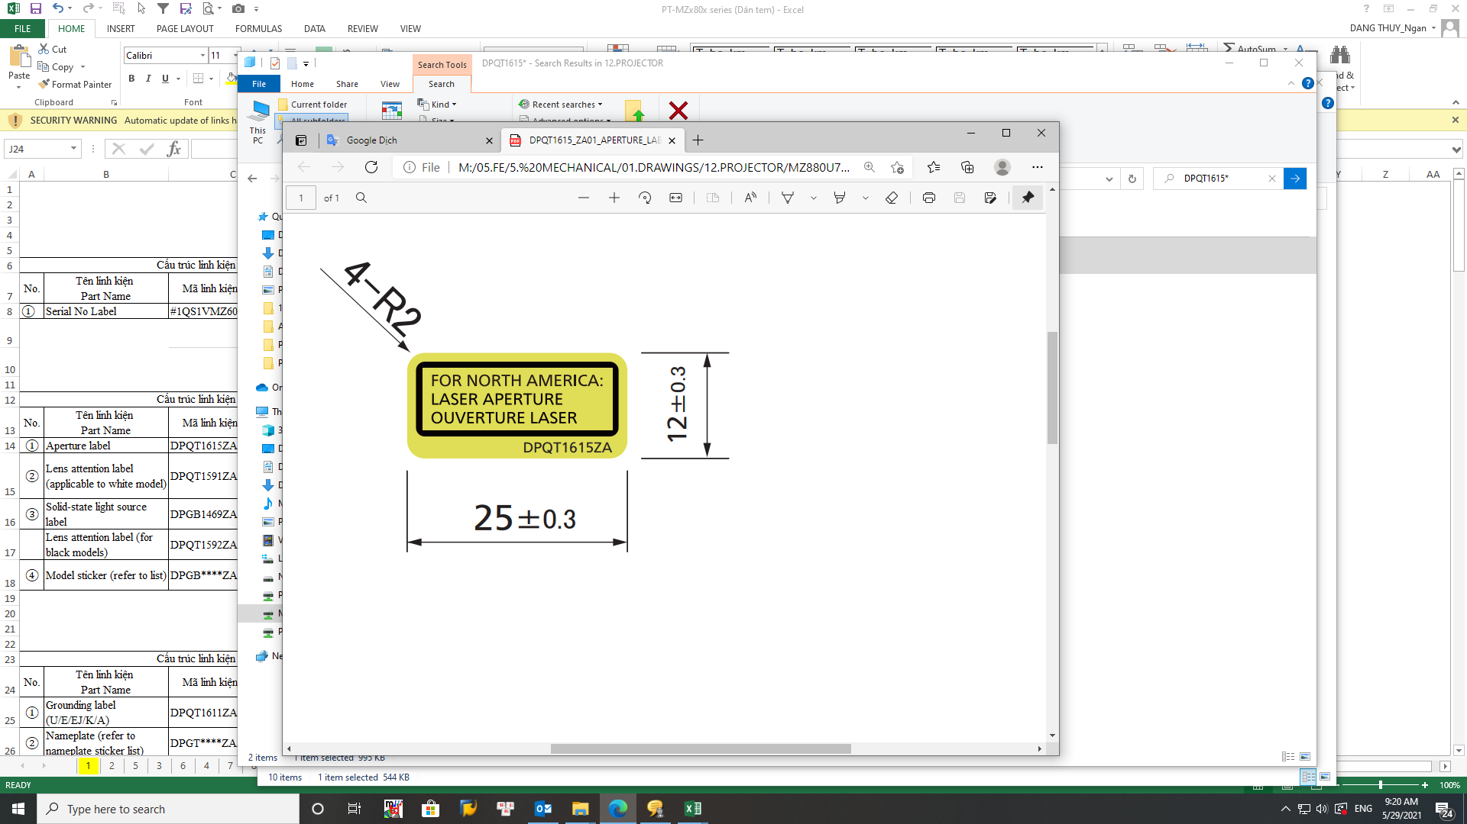

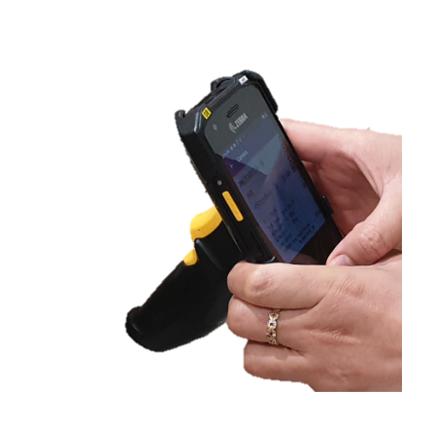
EXPLAIN APPEARANCE /PACKING OPERATION : VC MACHINE vs OCR
Simulation HC & Circle time Appearance & Packing process:
Compare function OCR vs VC machine :
Manual Appearance & Packing
Apply VC Machine & Packing By Robot Arm
Apply OCR VC & Packing By Robot Arm
VC machine check 30 items : Character, Logo , label, shape parts, screw
Invest: 25.6K$
Save labor cost: 12K/Yr
ROI: 2.19Yrs
LED
Parts shape
Logo
Label
screw
OCR check: 11 items
Character only [ Follow OCR MCS]
1 pax
4 pax
0 pax
2 pax
0 pax
2 pax
Invest:
Hardware (PDA):
Software: ???
Save labor cost: ……K/Yr
ROI: ……Yrs
LED
Parts shape
Logo
Label
screw
Appearance over TT : 1.7min
Packing under TT : 1.6min
→ Replace to hard work & share job for appearance process
Auto Appearance save HC: 1pax
Packing by robot aim save :2 pax
→Over TT : 0.9min → Share job for L.leader
Semi auto Appearance by OCR common HC with packing
Packing Over TT : 1.7min→ Need keep 1 pax appearance
Need ITS support
Study can apply OCR to appearance check or not?
2. Estimate Investment & Circle time for FA study can reduce HC or not?

